Slide 1


Enron North America
Equity Comparables
Report Date- June 2, 2000
Confidential

Slide 2
Equity Comparables
Project Objective:
The purpose of our review was to understand the process by which the equity comparable basket is developed and subsequently updated during deal execution and quarterly revaluation. Our review was designed to identify and to test significant policies, procedures and controls that ensure the comparable basket properly reflects investment characteristics and is developed in a consistent manner.
AA Team Members: Enron Team Members:
Tom Bauer Wes Colwell
Patricia Grutzmacher David Gorte
Derek Claybrook Bill McKone
Carrie Applewhite Andrea Reed
Michael Croom Jenny Riley
Mark Ruane
Jeff Soo

Slide 3
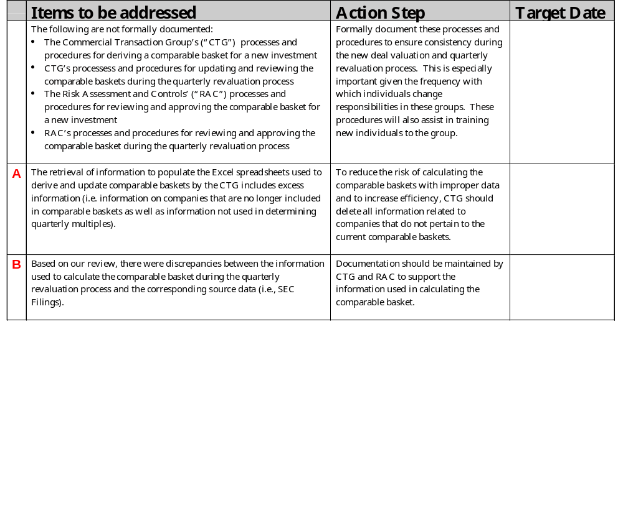
Equity Comparables Observations

Slide 4
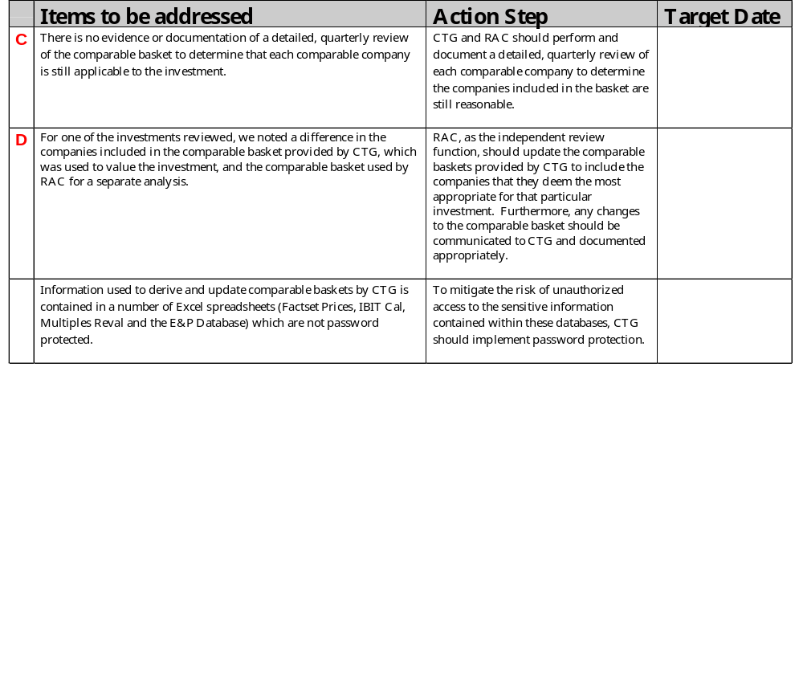
Equity Comparables Observations

Slide 5
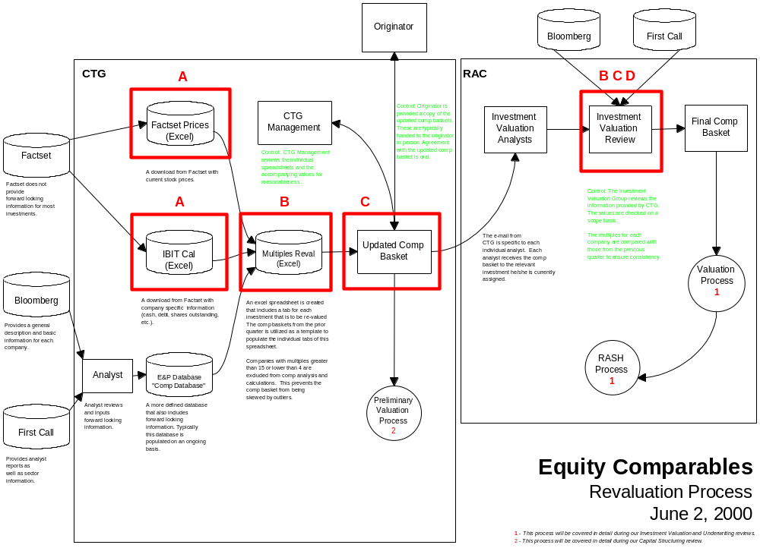

Slide 6
